Slide 1


Slide 2


PREDICTIVE MAINTENANCE FOR AUTONOMOUS ELECTRIC BUSES USING REAL-TIME
SENSOR DATA AND MACHINE LEARNING
Category:- Research Based
Team id/Name-26E3186/404_Syndicate
Pre-Final Year Project Synopsis
Submitted by
ROLL NO. | NAME
2401011487 | Rounit Kumar
2401011485 | Prince Kumar Gupta
2401011483 | Naman Bharadwaj
2401012482 | Shantna Kumar
Faculty Mentor: Ms. Kriti Sharma
Notes:
New Courses replaced with New Programmes

Slide 3
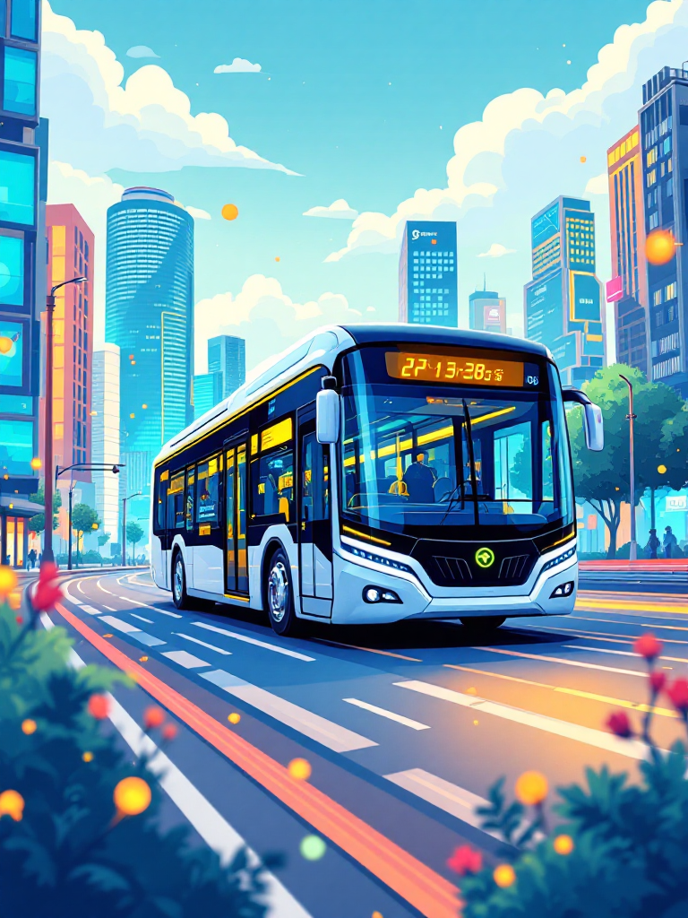

Introduction
Rapid urbanization has increased the demand for sustainable transportation, leading to the adoption of Autonomous Electric Buses
The complexity of these systems makes traditional maintenance methods inefficient and unreliable
Predictive Maintenance using real time sensor data is used to monitor system performance and detect faults early
Convolutional Neural Networks analyze sensor data to identify abnormal patterns and improve fault detection accuracy
This approach enhances reliability, safety, and overall efficiency of Autonomous Electric Bus operations.
Notes:
New Courses replaced with New Programmes

Slide 4
Specific Objectives
To analyze motion data from the MPU6050 IMU sensor for detecting abnormal acceleration and orientation patterns.
To evaluate vibration data from the piezo sensor for early identification of mechanical faults.
To utilize the ESP32 microcontroller for real-time data acquisition, processing, and communication.
To integrate multi-sensor data using CNN-based techniques for accurate fault detection and improved system reliability.
Notes:
New Courses replaced with New Programmes

Slide 5
Key Features
Multi Sensor Data Analysis: Uses MPU6050 and piezo sensors to monitor motion and vibration for detecting system abnormalities
Real Time Data Acquisition: ESP32 enables continuous data collection, processing, and communication
CNN Based Fault Detection: Applies Convolutional Neural Networks to analyze sensor data and identify faults accurately
Early Fault Prediction: Detects potential issues at an early stage to prevent major failures
Improved System Reliability: Enhances performance and maintenance efficiency through predictive techniques
Notes:
New Courses replaced with New Programmes

Slide 6
Progress Summary
Topic Completed: Predictive Maintenance for Autonomous Electric Buses finalized and fully explored
Literature Review: Comprehensive study of existing research on predictive maintenance, sensor systems, and machine learning techniques
Research Gap Addressed: Focus on real time, multi sensor based predictive maintenance using CNN
Methodology Implemented: Sensor data acquisition, preprocessing, and CNN based fault detection framework completed
Model Development: Machine learning models analyzed and CNN applied for accurate fault prediction
Results and Analysis: Performance evaluation carried out with improved fault detection and system reliability
Conclusion Derived: Predictive maintenance using sensor data and CNN enhances efficiency, safety, and reduces downtime
Notes:
New Courses replaced with New Programmes

Slide 7
Detailed Progress – Development Phase:
Framework designed for predictive maintenance using sensor data and machine learning
Data acquisition setup using MPU6050 for motion and piezo sensor for vibration monitoring
ESP32 configured for real time data collection, preprocessing, and communication
Sensor data preprocessed through cleaning, normalization, and structuring
CNN model developed for feature extraction and fault detection
Model trained and evaluated using prepared dataset
Multiple iterations performed to improve accuracy and performance
Successful integration of sensor data with CNN for real time analysis
Functional system achieved for detecting faults and monitoring system health
Foundation prepared for final analysis, results, and validation
Notes:
New Courses replaced with New Programmes

Slide 8
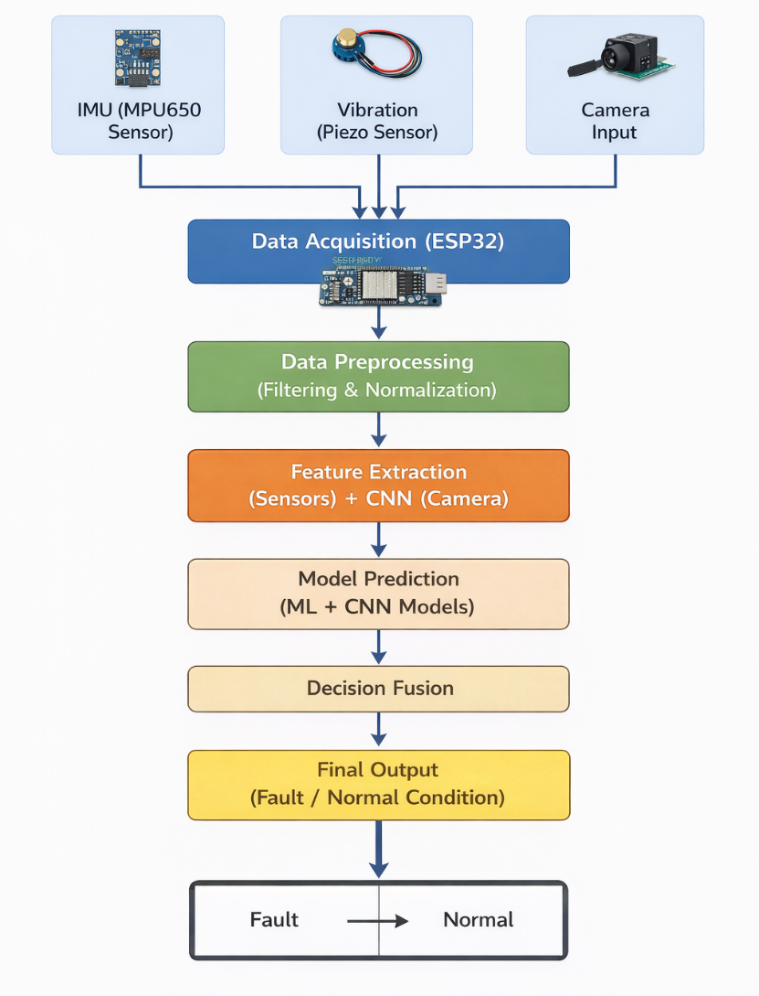
Methodology
Multi-modal data collected using IMU, vibration sensor, and camera
Real-time acquisition performed via ESP32
Data preprocessing using filtering and normalization techniques
Feature extraction from sensor data and CNN-based image analysis
Fault prediction using integrated ML and CNN models
Decision fusion applied to enhance prediction accuracy
Final classification into fault or normal condition
Notes:
New Courses replaced with New Programmes

Slide 9
Data & Resources:
Comprehensive Data Sources(as per system design)
IMU (MPU6050): acceleration and orientation data
Vibration sensor: fault-related vibration signals
Camera input: visual data for condition monitoring
Technological Framework
Cloud: AWS, Microsoft Azure
Database: MySQL
Data processing: Python (NumPy, Pandas)
CNN: image-based feature extraction & fault detection
Visualization: Tableau, Power BI
Notes:
New Courses replaced with New Programmes

Slide 10
Usecases & Scope: Beyond the Bus
Smart City Integration: Examine how predictive maintenance data can support urban traffic management systems and improve the efficiency of public transportation networks.
Application to Other EV Fleets: Study the potential of extending predictive maintenance approaches to other electric vehicle fleets such as delivery vehicles, ride-sharing cars, and autonomous taxis.
Cybersecurity Considerations: Investigate security challenges related to sensor data, data transmission, and predictive analytics systems in intelligent transportation environments.
Standardization and Policy Support: Analyze the need for industry standards and regulatory policies that encourage the adoption of predictive maintenance in autonomous public transportation systems.
Notes:
New Courses replaced with New Programmes

Slide 11
Expected Results & Impact
Early Fault Detection Detect potential faults in advance using CNN and sensor data
Improved Reliability & Safety Ensures stable and safe operation of autonomous electric buses
Reduced Cost & Downtime Minimizes unexpected breakdowns and maintenance expenses
Real-Time Monitoring Enables continuous system tracking and quick response
Better Decision-Making Provides data-driven insights for efficient maintenance planning
Notes:
New Courses replaced with New Programmes

Slide 12
THANK YOU!

